Slide 1
Lesson 3.14
Termination of Response
CGPRT(W) : Ensuring Clean Seas and Coasts in Western Region ……

Slide 2
Objective
To understand the issues related to response termination.
To understand the selection and definition of termination criteria.
To understand the consideration of any post-spill monitoring or studies.
CGPRT(W) : Ensuring Clean Seas and Coasts in Western Region ……

Slide 3
Termination of Response
Termination of response is one of the most delicate stages of oil spill response
  Difficult to reach agreement on completion of clean-up
    Offshore waters
    Along various diverse shorelines
  Competing interests
    Environmental
    Technical
    Economic
    Political
CGPRT(W) : Ensuring Clean Seas and Coasts in Western Region ……

Slide 4
Termination of Response
Typical questions during a response:
  If dispersants are being used, when should their application be terminated?
  At what point is it appropriate to demobilize recovery vessels?
  Is further clean-up of sandy beaches necessary?
In initial stages when a significant quantity of oil is present these decisions are easy to make.
When oil quantities on water or shoreline are diminishing the decision is not as easily determined.
CGPRT(W) : Ensuring Clean Seas and Coasts in Western Region ……

Slide 5
Law of Diminishing Returns
Oil plentiful in the early stages:
  high volume of oil treatment
As clean-up brought to a close:
  very little oil remains
At some point the costs of oil treatment are disproportionate to the benefits.
Oil Treated
Clean-up Effort
CGPRT(W) : Ensuring Clean Seas and Coasts in Western Region ……

Slide 6
Termination of Response
Objectives of response must be clearly established, if at all possible, before a spill even occurs, as part of the planning process
  Agreement between stakeholders
    Government
    Potential responsible parties including ship/facility owners
    Other key stakeholders such as landowners
  Set termination criteria
When these objectives are reached, response should end.
CGPRT(W) : Ensuring Clean Seas and Coasts in Western Region ……

Slide 7
Termination of Response
Overall objectives:
  At sea
    Attempt to treat oil to minimize pollution damages
  On shore
    Restore the use or value of the polluted area whilst minimizing further pollution damages
Need for specific termination criteria
How clean is clean?
CGPRT(W) : Ensuring Clean Seas and Coasts in Western Region ……

Slide 8
How clean is “clean”?
Definition of “clean” – must be agreed upon by key stakeholders and should be for specific areas and/or circumstances.
Considerations include:
  Natural processes and timescale
  Effectiveness of clean-up methods
  Socio-economic considerations
  Archaeological and cultural considerations
  Environmental benefits
  Perception of public and the media
  Consensus decision-making
CGPRT(W) : Ensuring Clean Seas and Coasts in Western Region ……

Slide 9
Termination Considerations
At sea clean-up:
  Measures no longer effective
  Further clean-up is likely to cause greater damage
  Level of response is out of proportion to the amount of oil on the water
  When the costs of the response are exceeding the likely benefits
CGPRT(W) : Ensuring Clean Seas and Coasts in Western Region ……

Slide 10
Termination Considerations
Shoreline clean-up
  Commitments agreed with authorities (in contingency plan) have been satisfied
  Further clean-up is likely to cause greater damage
  Point of diminishing returns is reached
  When cost of clean-up is out of proportion to area’s importance
  When economic loss caused by non-use of areas being cleaned exceeds any benefits
CGPRT(W) : Ensuring Clean Seas and Coasts in Western Region ……

Slide 11
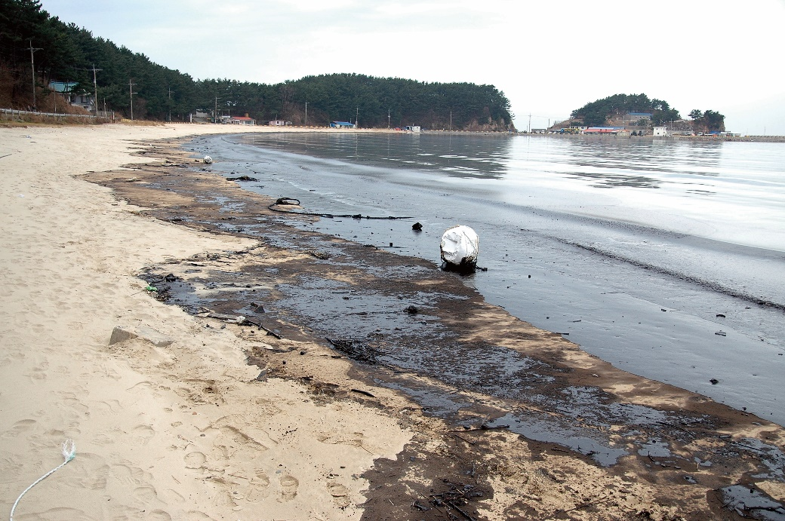
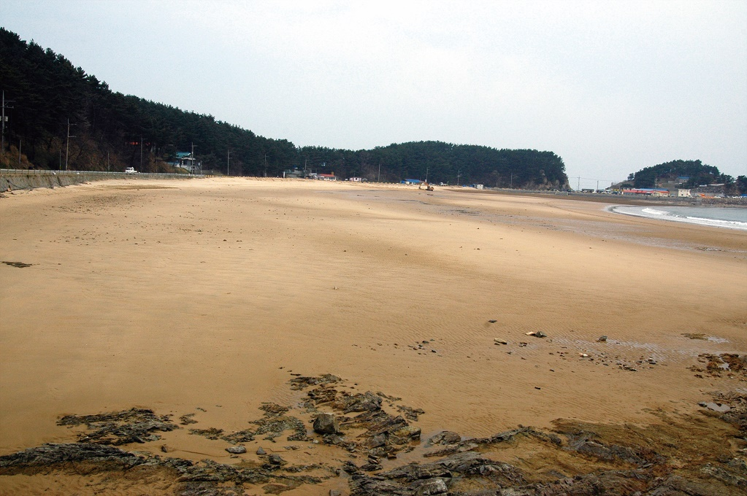
Termination Considerations
Source: Korea Coast Guard
CGPRT(W) : Ensuring Clean Seas and Coasts in Western Region ……

Slide 12
Example of Termination Criteria
Resource
Food and water (for human consumption)
Amenity beaches and structures
Water surface (used by birds, marine mammals)
Criteria
Statutory specifications and taste tests
No visible oil and no oil rubbing off on people or boats
No visible oil or sheen that might adhere to feathers or tar balls that could be ingested by marine mammals
CGPRT(W) : Ensuring Clean Seas and Coasts in Western Region ……

Slide 13
Example of Termination Criteria
Resource
Criteria
Subsurface water (habitat for fish, corals, sea grass, etc.)
Concentration and background levels. Must not be toxic to key species
Shoreline (habitat for algae, mangroves, molluscs, etc.)
Need not be visibly clean but residues must not inhibit recovery by smothering or toxicity
Shoreline (ecosystem interacting with other near-shore systems)
Residues must not be mobile to leach to other near-shore areas
CGPRT(W) : Ensuring Clean Seas and Coasts in Western Region ……

Slide 14
Termination of Response
Once active clean-up is terminated many tasks must be accomplished
  Operational tasks
    Remove equipment from field
    Clean-up of equipment
    Repairs and maintenance
    Re-stock
CGPRT(W) : Ensuring Clean Seas and Coasts in Western Region ……

Slide 15
Termination of response
  Administrative tasks
    Demobilization of personnel and equipment
    Finalize payments and contracts
    Compile costs
    Produce final incident report
    Prepare claims
    Conduct incident debriefing
    Implement lessons learned
    Conduct post-spill monitoring studies
CGPRT(W) : Ensuring Clean Seas and Coasts in Western Region ……

Slide 16
Post-spill Monitoring
Overall objectives
  To determine the nature and extent of damage
  To assess and monitor the recovery processes
Post-spill monitoring must answer specific questions such as:
  What are the levels of contaminants left in the environment by this incident?
  Are there any hydrocarbons in flesh of fish?
  Is there a change in bird populations? Marine mammals? Sea turtle nesting sites? Migratory fish?
CGPRT(W) : Ensuring Clean Seas and Coasts in Western Region ……

Slide 17
Post-spill Monitoring
Designing a post-spill monitoring study
  Determine monitoring objectives
    Ex: evaluate hydrocarbon levels in sediments
  Determine geographical extent
    Ex: Beach 1 and 5
  Determine study parameters
    Ex: Total hydrocarbons
  Elaborate sampling plan
    Ex: Monthly, 5 sampling stations, 3 samples/station
CGPRT(W) : Ensuring Clean Seas and Coasts in Western Region ……

Slide 18
Post-spill Monitoring
Designing a post-spill monitoring study
  Determine study timeframe
    Ex: 12 months
  Decide on interpretation of results
    Comparison with pre-spill data
    Comparison with uncontaminated reference sites
    Changes over time
  Carry out study and write report
  Identify required restoration measures
CGPRT(W) : Ensuring Clean Seas and Coasts in Western Region ……

Slide 19
Post-spill Monitoring
Collaboration between government and responsible party is desirable during the whole process
It will avoid:
  Duplication of efforts
  Varying results due to differences in methodology
  “Battle of experts”
Collaboration will ensure quicker implementation of restoration measures and treatment of claims
CGPRT(W) : Ensuring Clean Seas and Coasts in Western Region ……

Slide 20
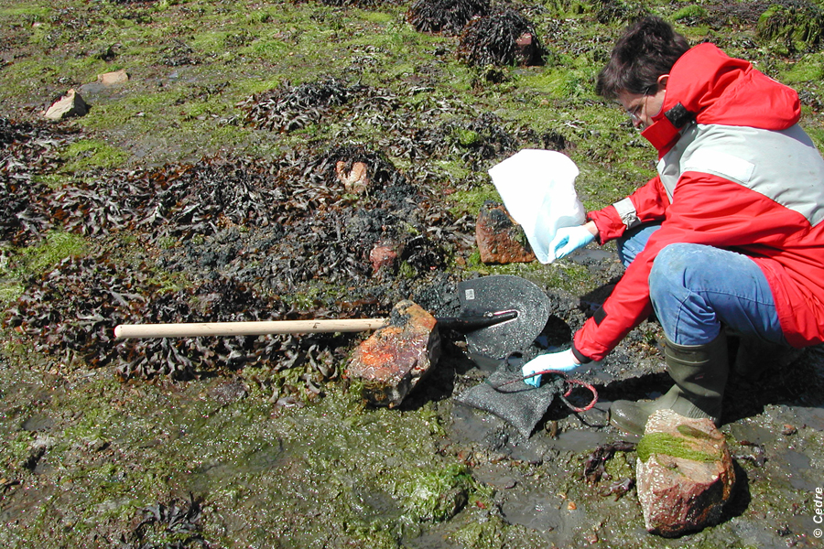
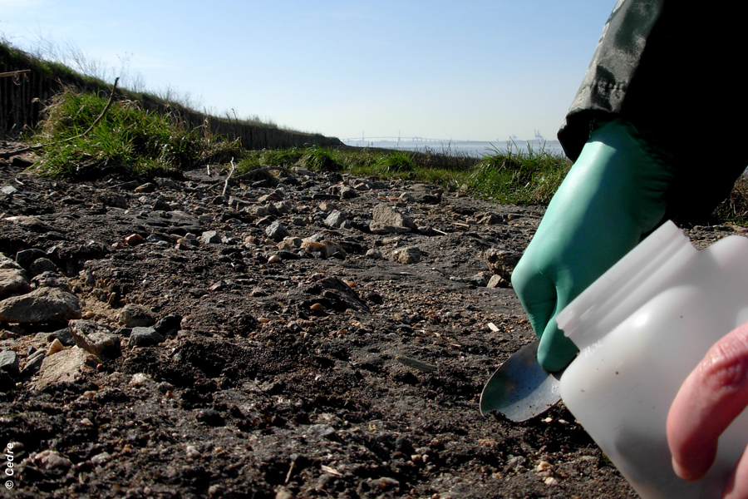
Post-spill Monitoring
CGPRT(W) : Ensuring Clean Seas and Coasts in Western Region ……

Slide 21
Restoration
Measures to speed up recovery from environmental damages
Aim to bring back environmental function to what it was prior to a spill
Various methods:
  Planting (mangroves, marshes)
  Restricting access to particular habitat
  Predator control
Must have a realistic chance of success for compensation
CGPRT(W) : Ensuring Clean Seas and Coasts in Western Region ……

Slide 22
Conclusion
Termination of response is often a contentious issue
General response objectives and end-point criteria must be established during the planning process and the specifics of such made clear at the beginning of a spill in a collaborative manner
Operational and administrative tasks are needed to close a spill
Adopt a collaborative approach for the design of post-spill monitoring studies.
CGPRT(W) : Ensuring Clean Seas and Coasts in Western Region ……

Slide 23
Any questions?
CGPRT(W) : Ensuring Clean Seas and Coasts in Western Region ……

